Slide 1

Basics of DHCP: Cisco Lab

Slide 2
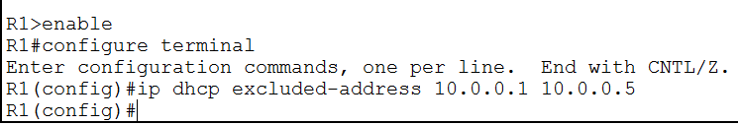
Excluding Addresses From the Pool
Done in global configuration mode
Excludes a range of IP address from the pool

Slide 3
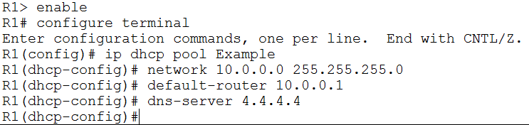
Creating a DHCP Pool
Creates a pool of addresses for the server to lease
Required parameters
Network number
Subnet mask
Default gateway
DNS server

Slide 4
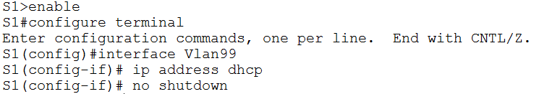
Assigning a DHCP Address to an Interface
Done in interface configuration

Slide 5
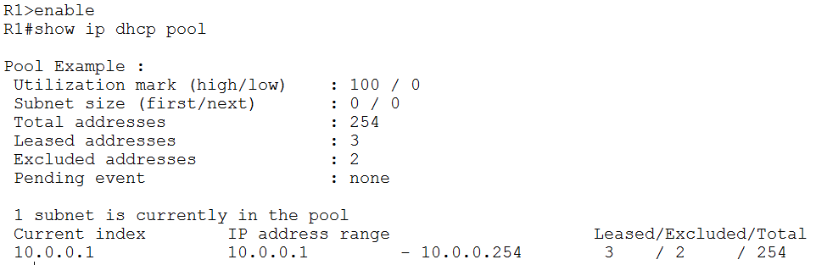
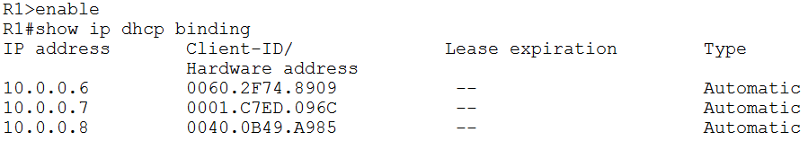
Verifying DHCP

Slide 6
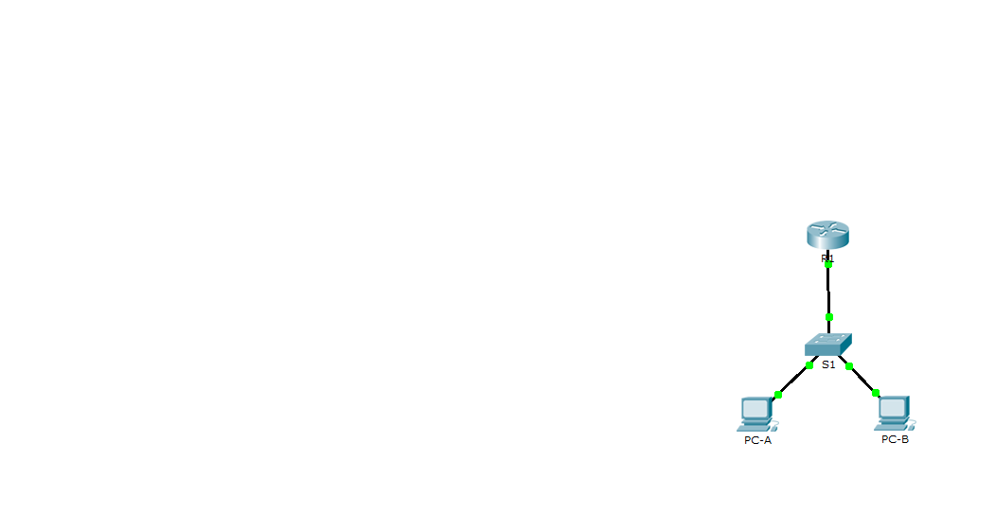
Lab: Topology
Device | Interface | IP Address | Subnet
R1 | G0/0 | 192.168.1.1 | 255.255.255.0
S1 | Vlan 1 | DHCP
PC-A | NIC | DHCP
PC-B | NIC | DHCP
GigabitEthernet0/0
GigabitEthernet0/1
FastEthernet0/1
FastEthernet0/2
NIC
NIC

Slide 7
Lab: Configure R1
Assign an IP address to R1
192.168.1.1 255.255.255.0
Exclude the first 10 addresses
192.168.1.1 – 192.168.1.10
Create DHCP pool
Name: SeaSharp
Network: 192.168.1.1
Subnet: 255.255.255.0
Default gateway: 192.168.1.1
DNS: 8.8.8.8

Slide 8
Lab: Configure DHCP clients
Assign DHCP address to S1 on Vlan 1
Assign DHCP addresses to PC-A and PC-B

